Slide 1
Angular Advance
By sandip

Slide 2
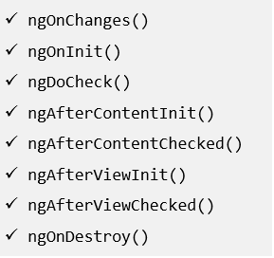
Life Cycle Hooks
Angular calls lifecycle hook methods on directives and components as it creates, changes, and destroys them.
Angular manages lifecycle of components and directives.
A directive has the same set of lifecycle hooks, minus the hooks that are specific to component content and
views.
Angular inspects directive and component classes and calls the hook methods if they are defined.

Slide 3
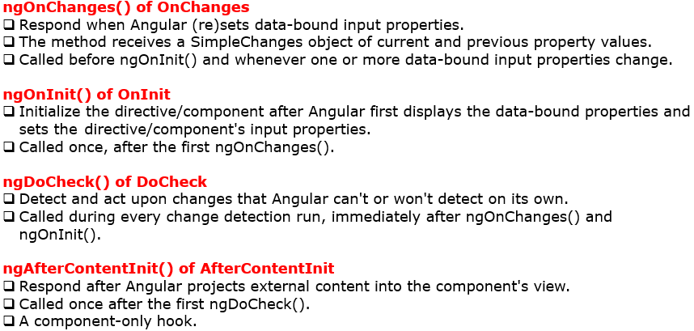
Life Cycle Hooks

Slide 4
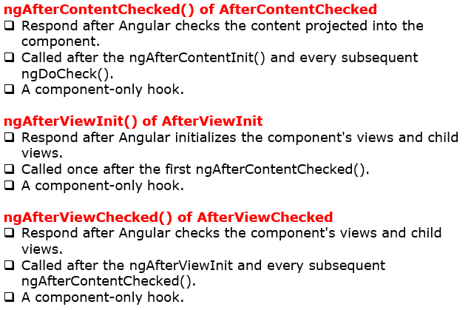
Life Cycle Hooks

Slide 5
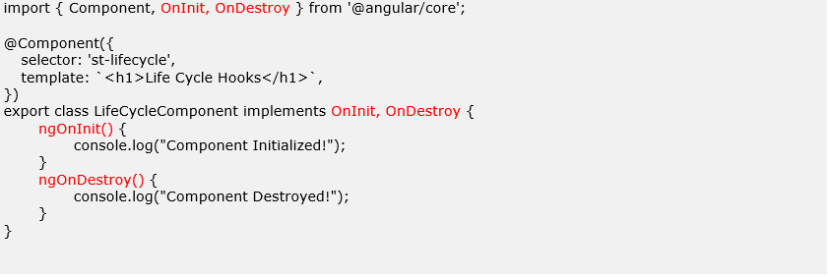
Life Cycle Hooks- Example

Slide 6
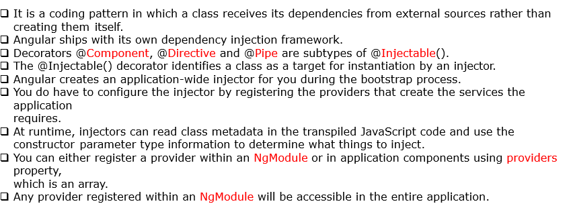
Dependency Injection

Slide 7
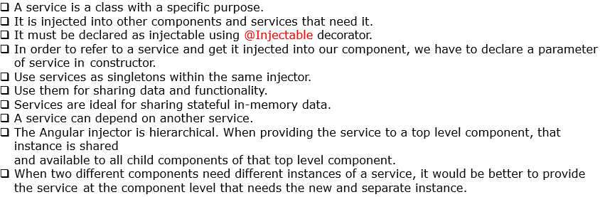
Services

Slide 8
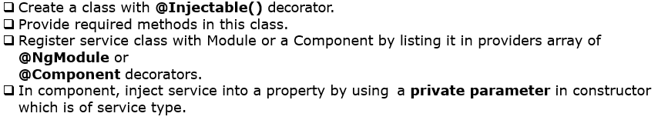
Steps to create and use Services

Slide 9
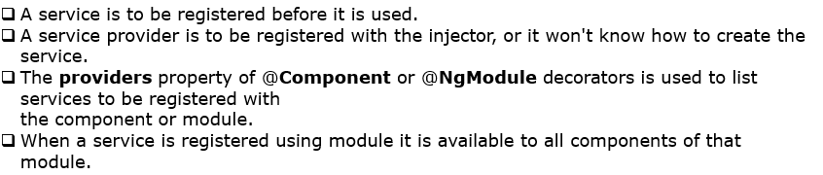
Providers Property

Slide 10
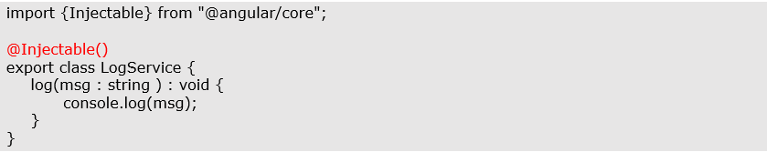
log.service.ts

Slide 11
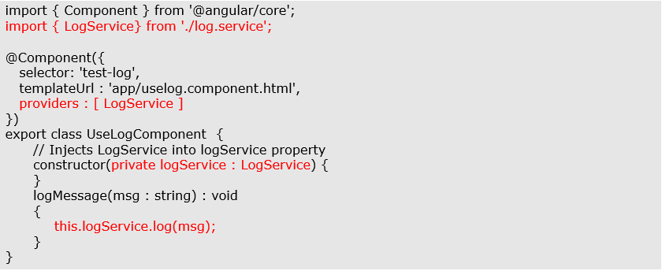
uselog.component.ts

Slide 12
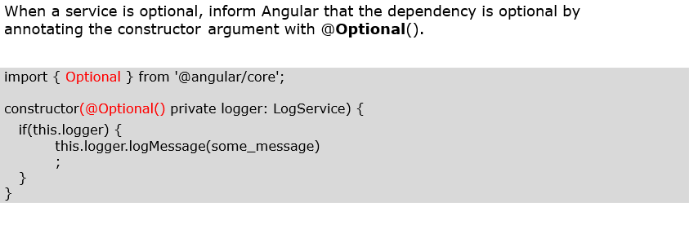
Optional Dependency

Slide 13

Component Interaction

Slide 14
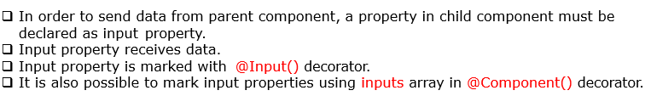
Input Property

Slide 15
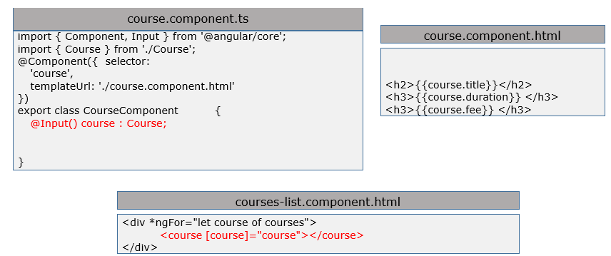
@Input() Example

Slide 16
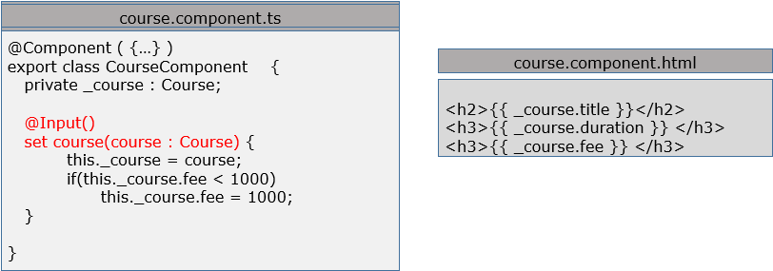
Using setter method for input property

Slide 17

Parent listens to child event

Slide 18
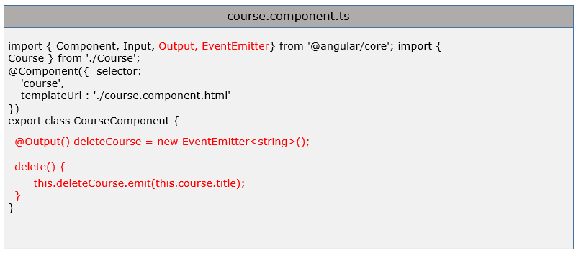
Child sending event to parent example

Slide 19
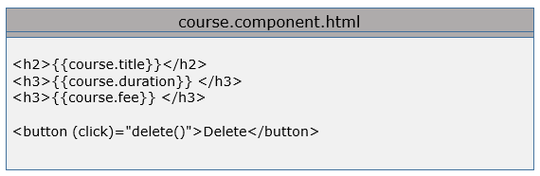
Child sending event to parent example

Slide 20
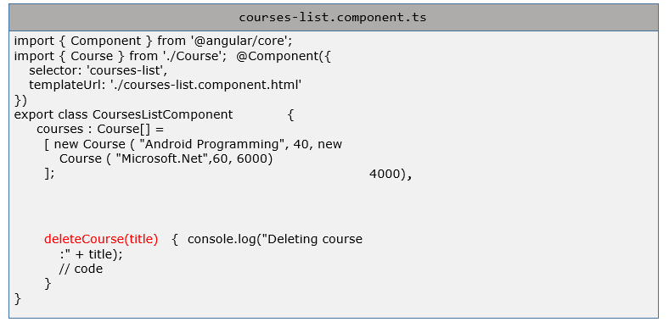
Child sending event to parent example

Slide 21
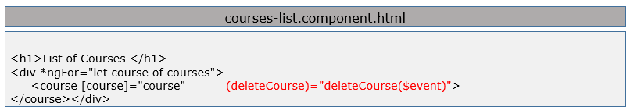
Child sending event to parent example

Slide 22
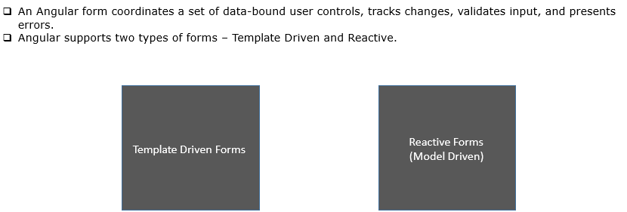
Forms

Slide 23
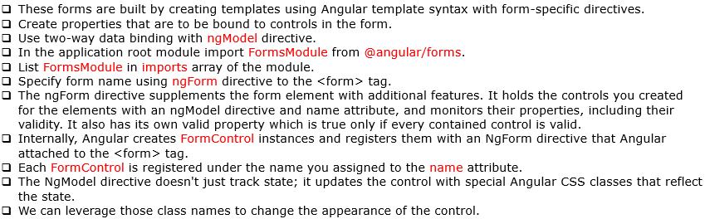
Template Driven

Slide 24
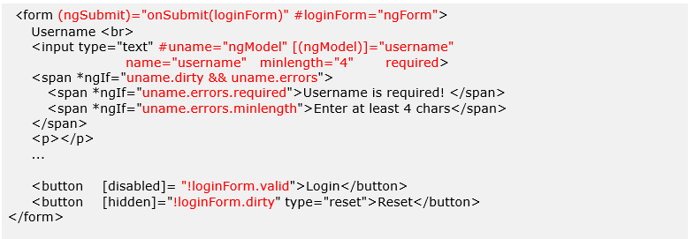
Example

Slide 25
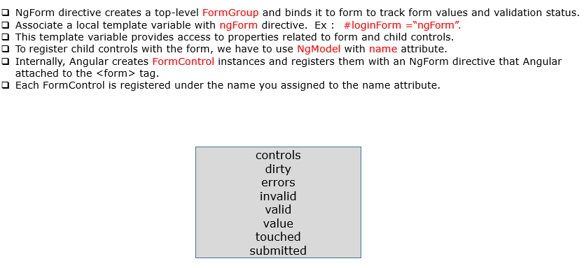
NgForm Properties

Slide 26
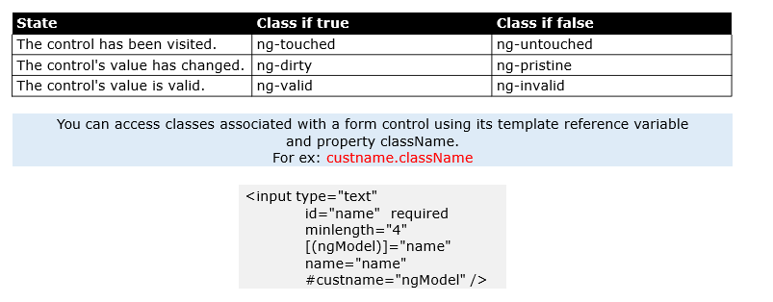
Classes associated with FormControl

Slide 27
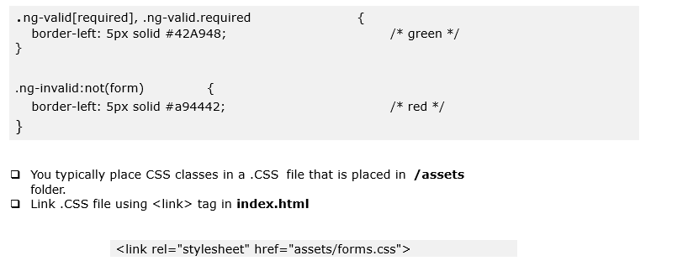
Using CSS Classes

Slide 28
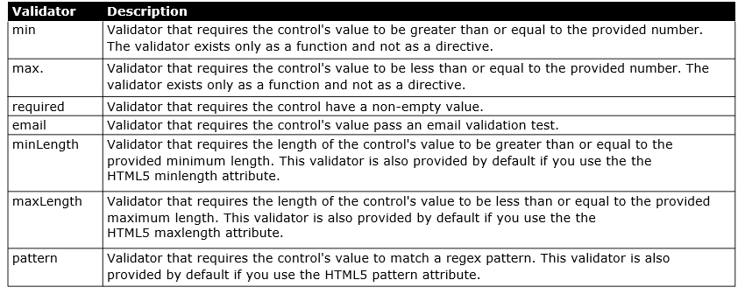
Built-in Validators

Slide 29
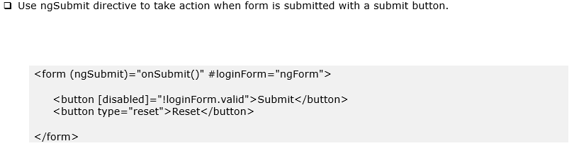
Submitting Form

Slide 30
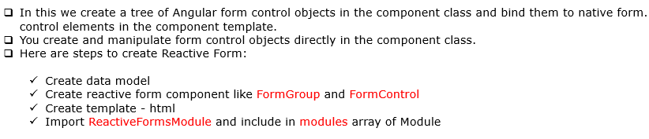
Reactive Forms (Model Driven Forms)

Slide 31
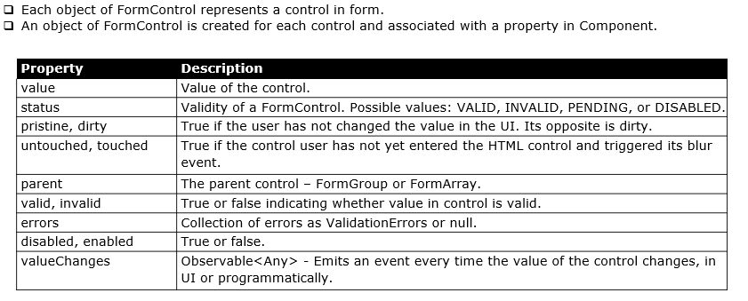
FormControl

Slide 32
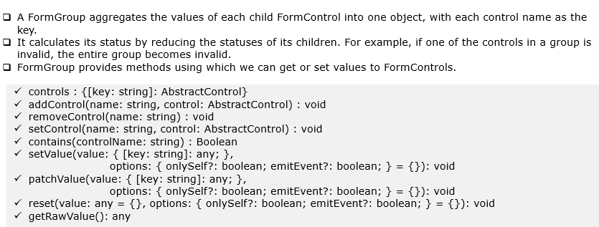
FormGroup

Slide 33
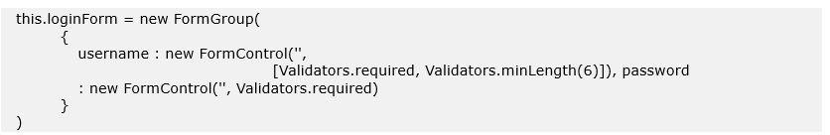
FormGroup Example

Slide 34
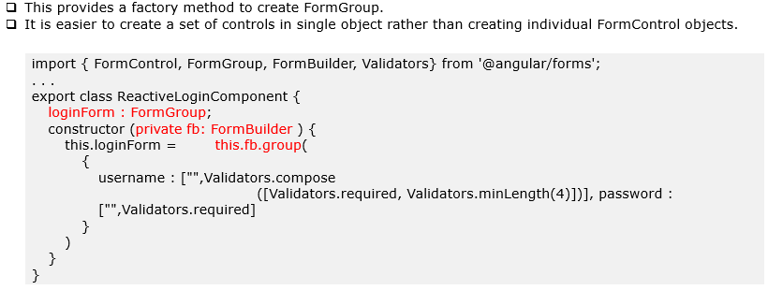
FormBuilder

Slide 35
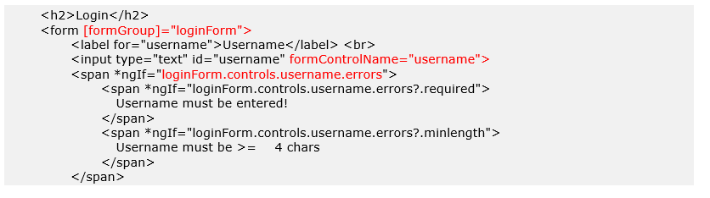
Reactive Form Template – Example Page 1

Slide 36
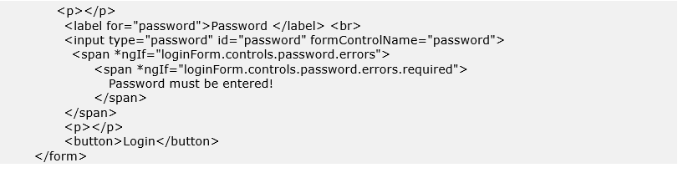
Reactive Form Template – Example Page 2

Slide 37
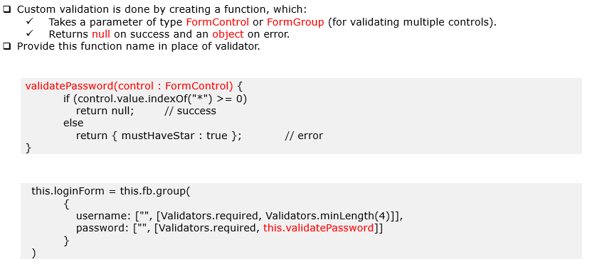
Custom Validation

Slide 38
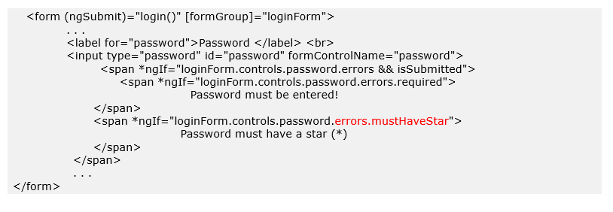
Custom Validation- Form

Slide 39
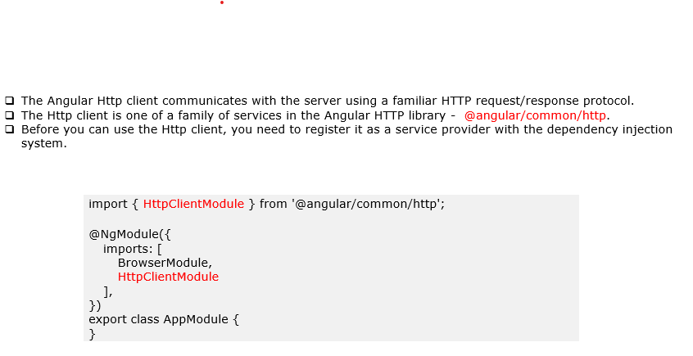
Making Ajax calls with HttpClientModule

Slide 40
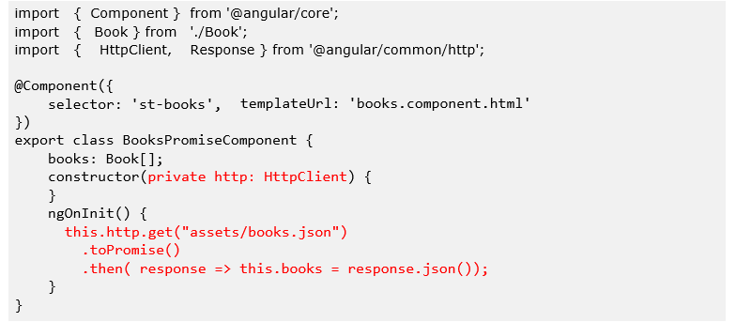
Using Promise

Slide 41

Observable

Slide 42

Important Terms

Slide 43
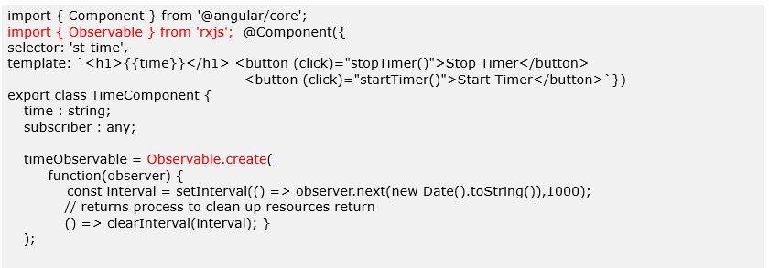
TimeComponent - Displays running digital clock

Slide 44
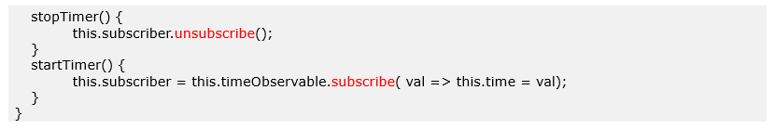
TimeComponent - Displays running digital clock

Slide 45
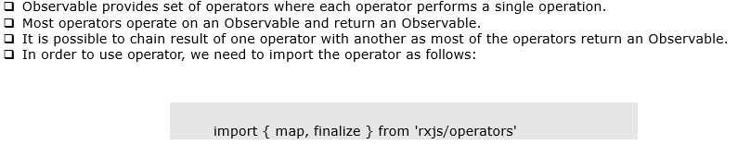
Observable Operators

Slide 46
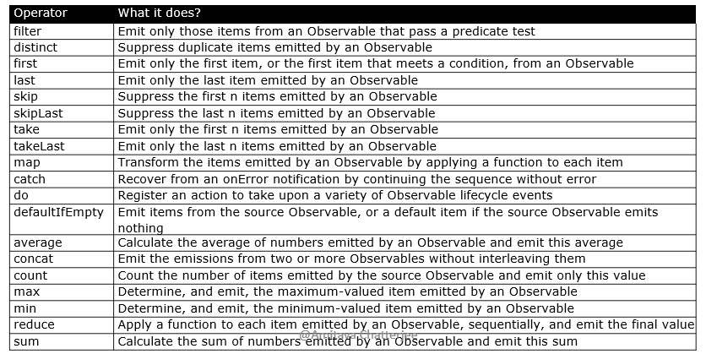
Observable Operators

Slide 47
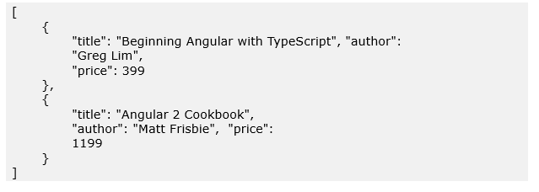
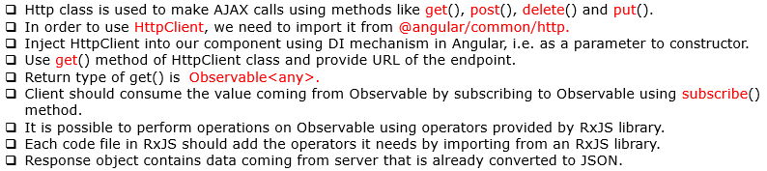
HttpClient class

Slide 48
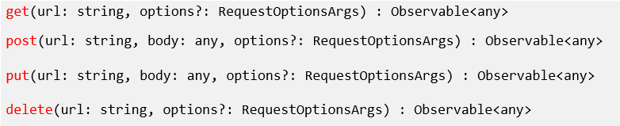
HttpClient Class Methods

Slide 49
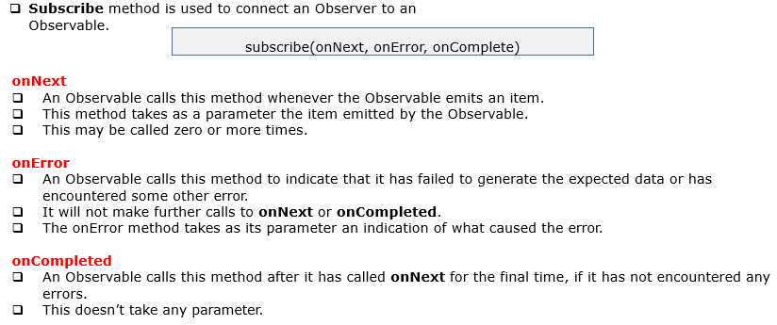
Subscribe Method

Slide 50
assets/Books.json

Slide 51
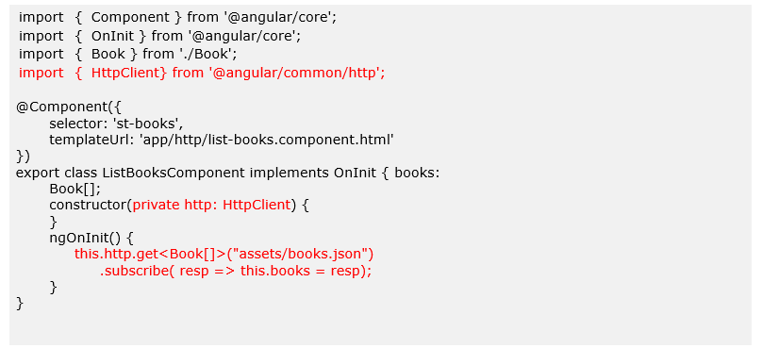
list-books.component.ts

Slide 52
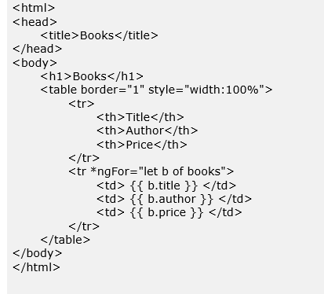
list-books.component.html

Slide 53
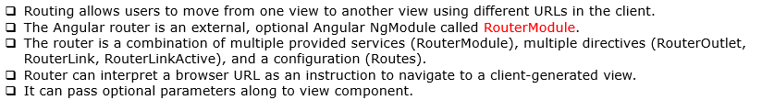
Routing

Slide 54
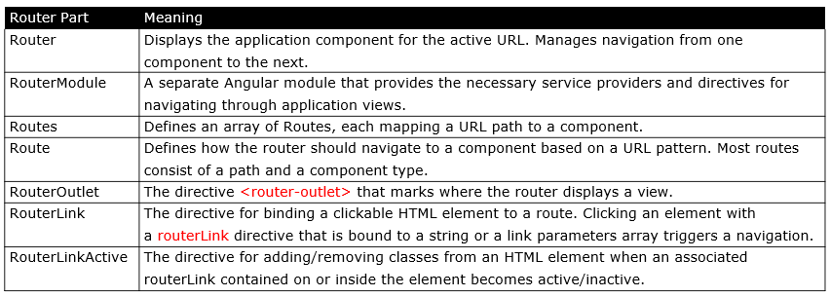
Routing Components

Slide 55
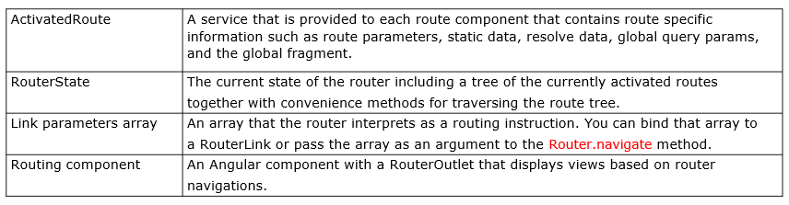
Routing Components

Slide 56

Step 1- <base href>

Slide 57

Step 2- Import Router

Slide 58

Step 3- Route Configuration

Slide 59

Step 3- Route Configuration

Slide 60

Step 3- Route Configuration

Slide 61

Step 4- Place <router-outlet>

Slide 62

Step 5- Use RouterLink directive

Slide 63

Step 5- Use Router Parameters

Slide 64

Step 5- Read Router Parameters

Slide 65

Programmatic Navigation

Slide 66

Route Guard

Slide 67

Step 1 – Create Route Guard

Slide 68

Step 2 – Associate Guard with Route

Slide 69

Step 3 – Declare Route Guard in Providers Array

Slide 70

Deployment

Slide 71

Tools

Slide 72

Ahead-of-Time (AOT) compilation

Slide 73

Build Project

Slide 74

Tree-shaking

Slide 75

Dead code elimination (DCE)

